Slide 1
2014 Annual General Meeting

Slide 2
Treasurer’s Report

Slide 3
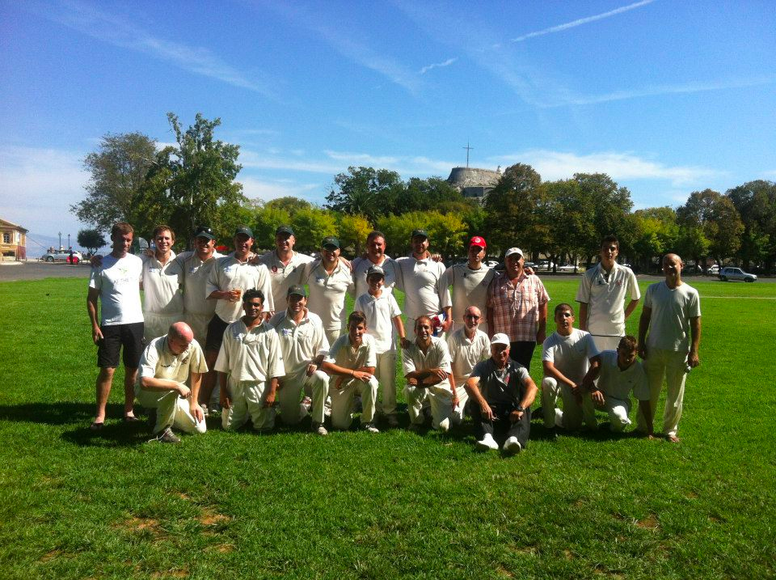
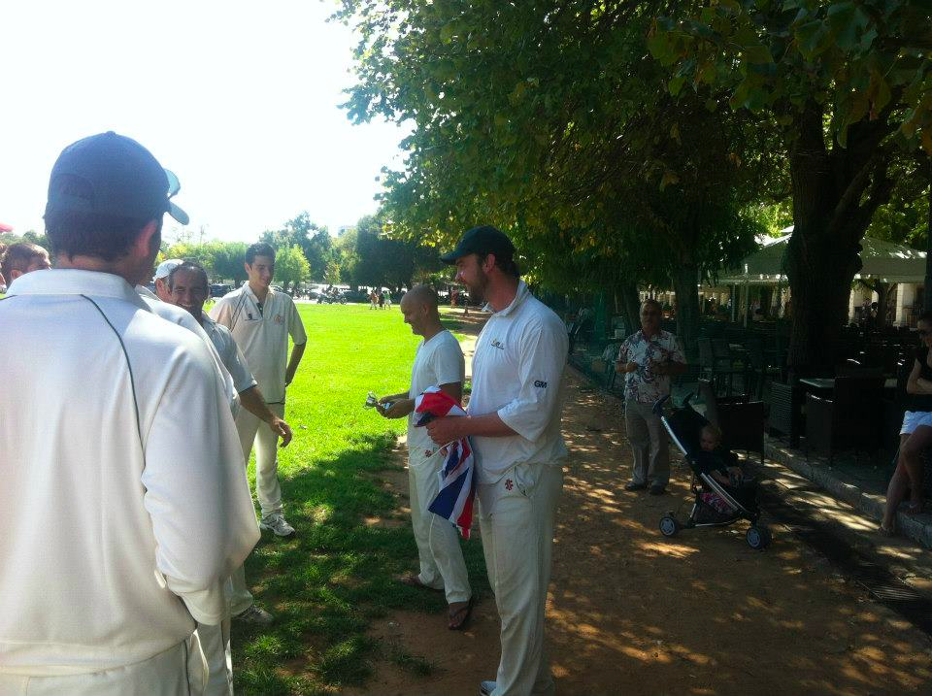
Village CC Tour 2015 – Building on Brilliance
Corfu 2012

Slide 4
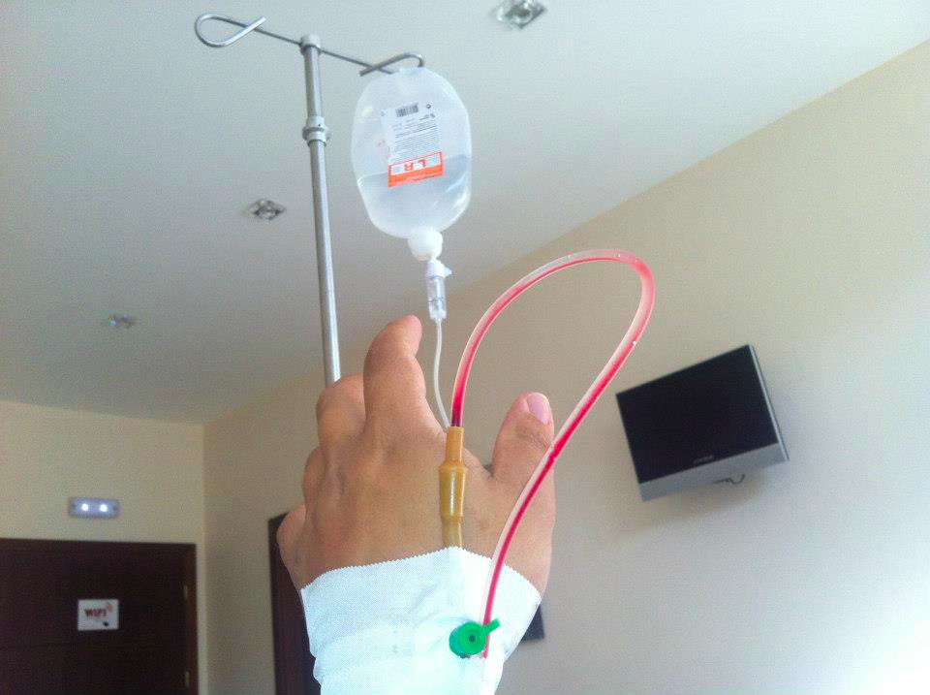
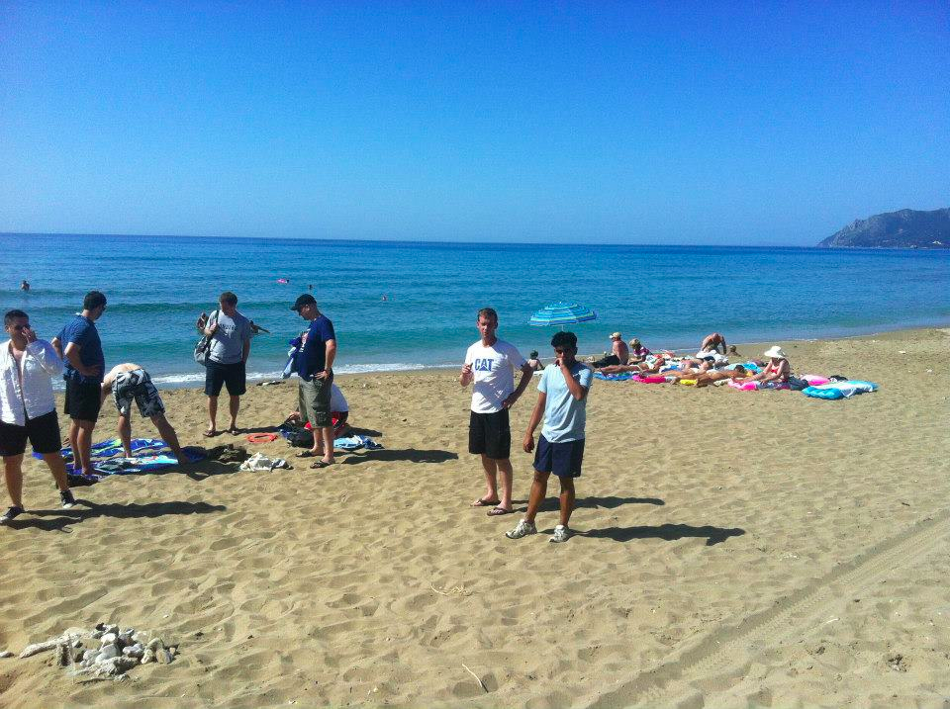
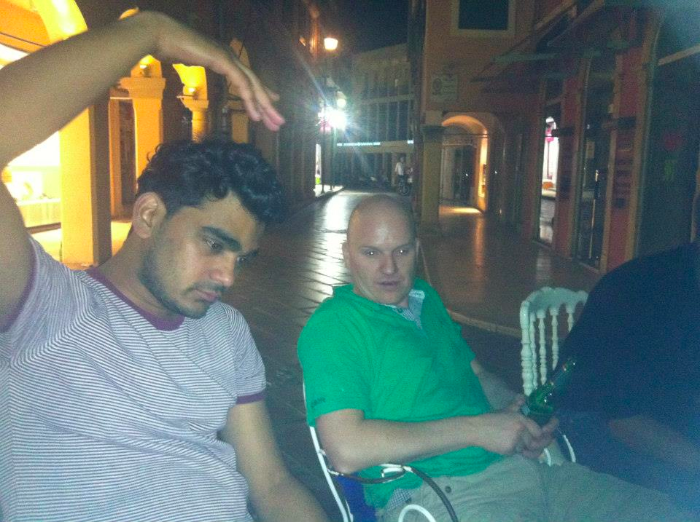
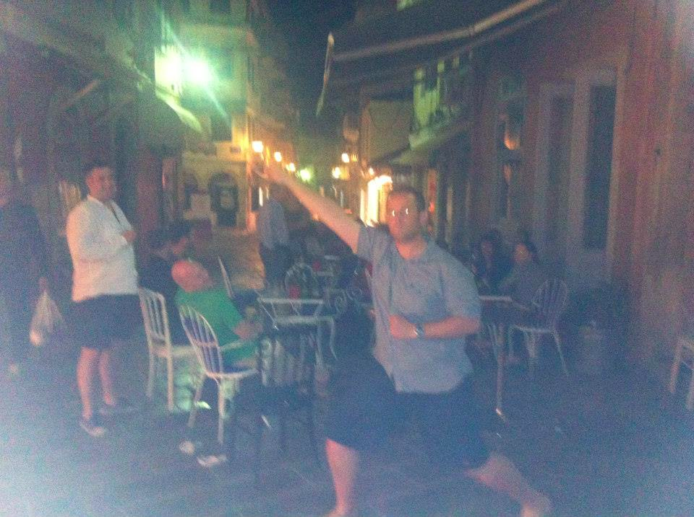
We thought long and hard about how to build on the brilliance of Corfu 2012…

Slide 5
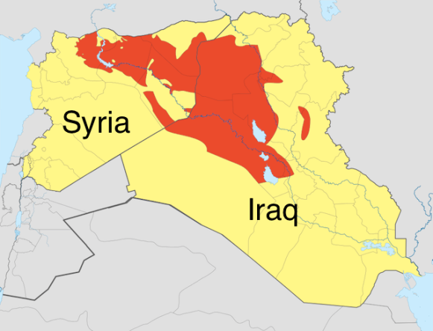
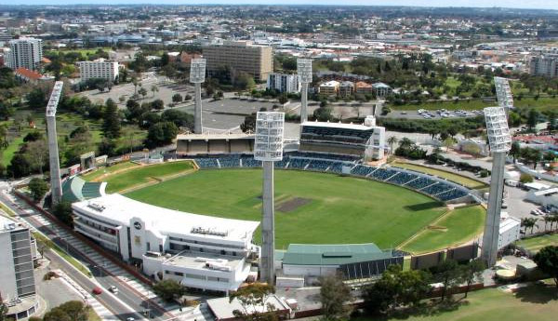
But there were some options we ruled out
Hong Kong
The Islamic State of Iraq and the Levant
Perth

Slide 7
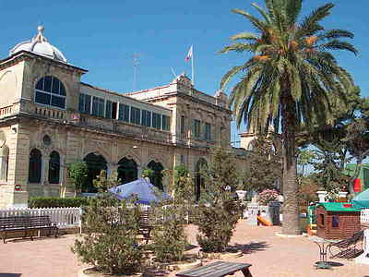
Village CC Tour 2015 – Building on Brilliance
We bring you Malta 2015

Slide 8
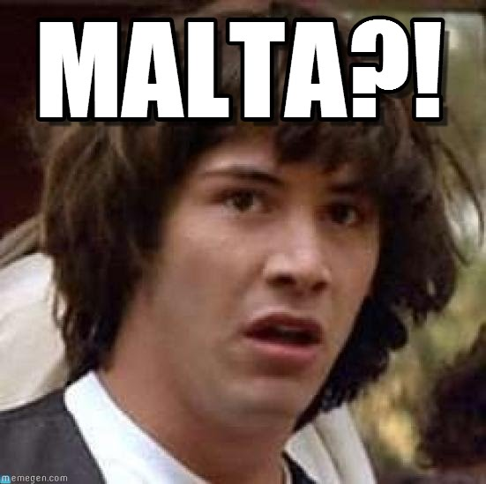

Slide 9
Village CC Tour 2015 – Building on Brilliance
Need to know
3-4 nights
Weekend of 25th/26th April 2015
2 fixtures
1 ‘other’ potential activity such as boat cruise, kayaking or tour of a vine-yard
Approx. £400pp including accommodation, flights, match fees and internal transfers

Slide 11
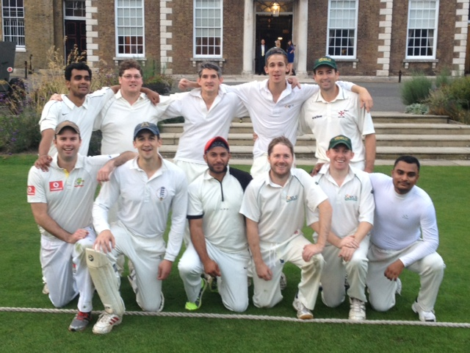
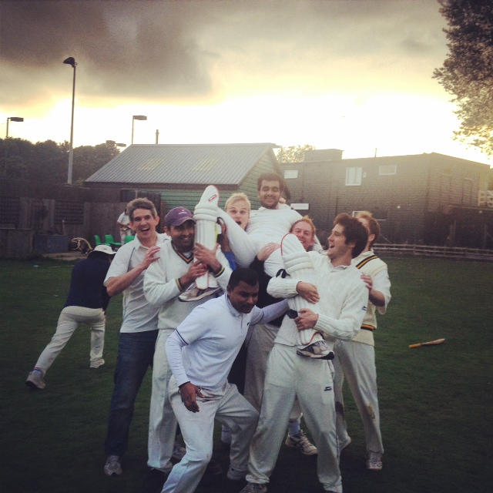
2014 Season in Review Captain’s Report

Slide 12
Review of the 2014 season - Stats
Club records set this year
Highest winning percentage - 88% (15 wins / 2 losses)
Fewest losses recorded - 2 (Hobgoblins & H.A.C)
In addition…
We bowled 11 teams out this season – Equal club record
Our 7 game Heath Streak (achieved twice) is equal second in the club’s history.
Club record over one season is 9 wins to end the 2010 season under KP. This was followed by 7 wins in a row to begin the 2011 season under Ek.

Slide 13
Review of the 2014 season - Stats
11 players made fifties – Equal club record
8 players with 10 wickets or more – Equal club record
Team batting average of 24.4 (131 wickets for 3201 runs)
Team bowling average of 16.1 (142 wickets for 2293 runs)
33 players played for the club including 9 debutants
Off the field…
We had post game drinks after every game
Two (soon to be three) Villagers got married, Harty got engaged while single Villagers continued to swipe right on Tinder

Slide 14
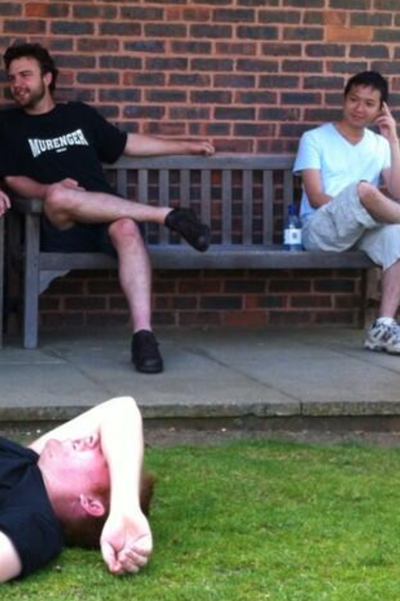
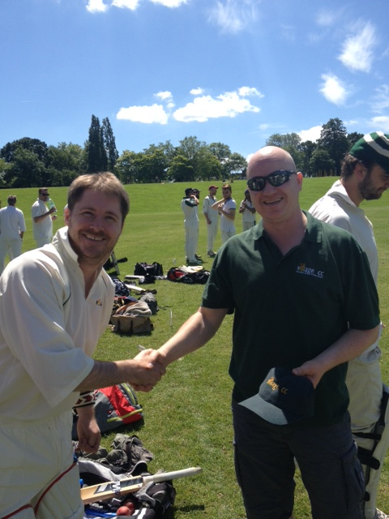
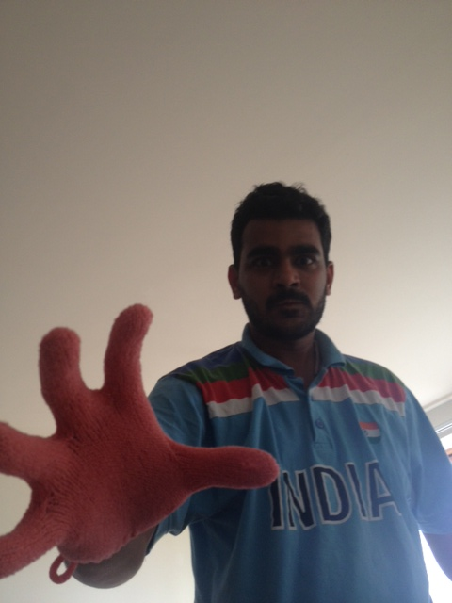
2014 milestones
100 games KP, Ek & WLD
100 wickets Matty Boa
50 catches WLD
2000 runs WLD & Troja
1000 runs Ek
First ever fifty Becker

Slide 15
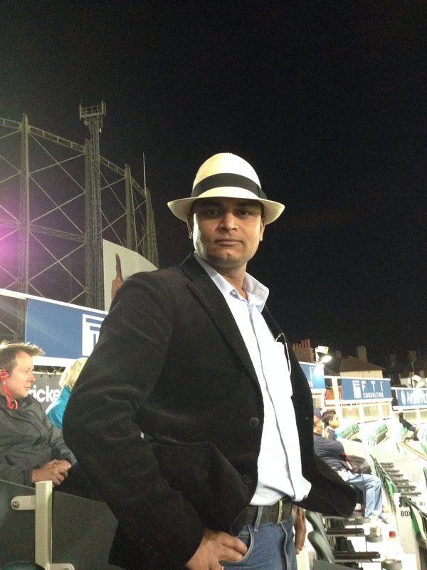
New faces for 2014

Slide 16
Review of the 2014 season - Fielding
Fielding stats & Fielder of the Year
59 catches
13 - WLD
6 - TdM
5 - Pontin
4 - Troja & Pitcher
3 - JdM, Harty & Thomo
34 dropped catches
5 - Gupte
4 - Troja
3 - JdM, WLD, Pitcher & Prash
2 - TdM, Sam, Boa & Thomo
1 - Naz, Louse, Puffett, Tupper & Ball
We took 63% of our chances

Slide 17
Review of the 2014 season -Bowling
Bowler of the season
 | Overs | Runs conceded | Average | S/R | Best figures | Wickets
Eklavya GUPTE | 60 | 303 | 15 | 19 | 3/25 | 19
Nick THOMPSON | 88 | 311 | 16 | 27.8 | 4/11 | 19
Matt BOA | 67 | 249 | 15 | 25.1 | 3/8 | 16
Craig WOODHOUSE | 35 | 158 | 11 | 15 | 5/17 | 14
Nick TROJA | 38 | 206 | 18 | 20.7 | 3/13 | 11
Chris PITCHER | 42 | 264 | 24 | 22.9 | 2/14 | 11
Naz CHOUDHURY | 45 | 180 | 18 | 27 | 4/23 | 10
Toby DE MELLOW | 66 | 216 | 21 | 39.6 | 2/18 | 10

Slide 18
Review of the 2014 season -Batting
Batsman of the season
 | Innings | Fifties | Average | Sixes | Fours | Runs
Nick TROJA | 11 | 6 | 64.9 | 22 | 44 | 454
Frank EXTRAS | 18 | 0 | 23.8 | 0 | 0 | 428
James DE MELLOW | 12 | 2 | 24.2 | 1 | 50 | 290
Steve HARTY | 7 | 2 | 71.8 | 8 | 34 | 287
Ollie MORGANS | 13 | 1 | 26.7 | 0 | 30 | 267

Slide 19
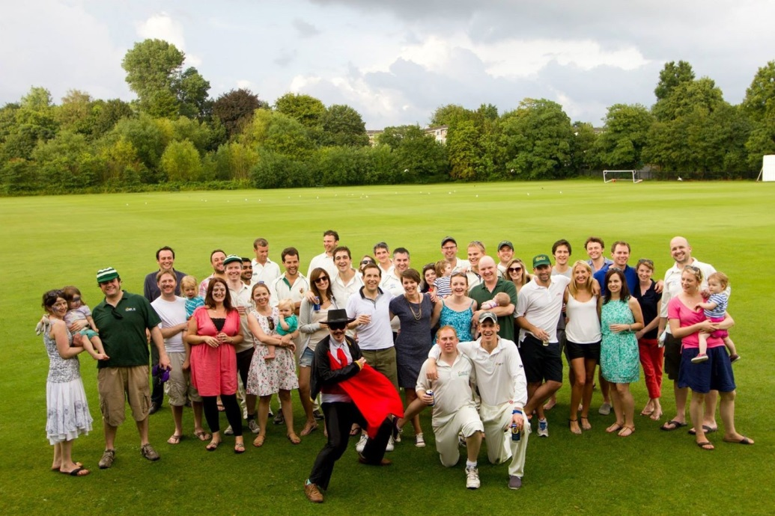
Village is 10

Slide 20
Captain’s Player of the Season
Match 1 vs Pecos XI (won by 6 wickets)
3. M Boa (3/14)
2. O Morgans (28*)
1. T de Mellow (2/22) DEBUT
Match 2 vs Agricola (won by 18 runs)
3. N Thompson (4/11)
2. E Gupte (3/25)
1. H Kaso (67)
Match 3 vs Southwark and Lambeth CC (won by 39 runs)
3. P Bowman (3/18)
2. L Becker (47)
1. E Gupte (3/37)
Match 4 vs Clapham Inn CC (won by 138 runs)
3. S Harty (70*)
2. C Pitcher (“that catch”)
1. D Chopra (2/7)
Match 5 vs Old Whitgifts (won by 34 runs)
3. C Woodhouse (5/28)
2. R Cressey (58)
1. J de Mellow (55)
Match 6 vs COBCC (won by 4 runs)
3. B Husain (2/17)
2. S Harty (34*)
1. G Pontin (27*)

Slide 21
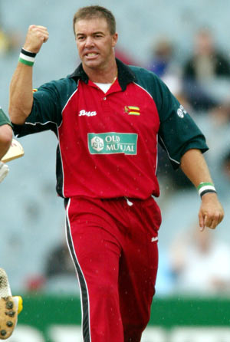
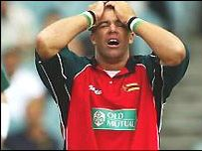
Captain’s Player of the Season
Match 7 vs Cross Keys CC
(won by 6 wickets)
3. C Woodhouse (5/17)
2. S Harty (39*)
1. O Morgans (27*)
Match 8 vs Hobgoblin Nomads
(lost by 2 wickets)
3. C Pitcher (12 runs but batted for 12 overs)
2. M Boa (3/8)
1. N Thompson (2/16)

Slide 22
Captain’s Player of the Season
Count after 8 matches
7 votes - Harty
6 votes - Woodhouse
5 votes - Pitcher & Boa
4 votes - Thomo
3 votes - Ek, WLD, Bilal & KP
2 votes - Becker & Cressey
1 vote - Pontin, Chopra, Kaso, JdM & TdM

Slide 23
Captain’s Player of the Season
Match 9 vs Strongroom CC
(won by 118 runs)
3. J de Mellow (75)
2. N Choudhury (4/23)
1. L Becker (58)
Match 10 vs Nomads CC abandoned
Match 11 vs DemiJohns CC
(won by 4 wickets)
3. E Gupte (2/30 and 22)
2. N Thompson (2/48 and 11*)
1. M Boa (2/31)
Match 12 vs HAC (won by 86 runs)
3. T de Mellow (98)
2. N Thompson (2/18)
1. C Woodhouse (2/22)
Match 13 vs St Anne’s Allstars
(won by 5 wickets)
3. J de Mellow (4/22)
2. J Hillier (2/15 and 42*) DEBUT
1. O Morgans (35 - reverse sweep)
Matches 14 & 15 against Rampant Badgers and London Fields abandoned
Match 16 vs Strongroom
(won by 62 runs)
3. B Husain (3/13)
2. S Harty (62)
1. M Boa (3/51)

Slide 24
Captain’s Player of the Season
Match 17 vs Southwark and Lambeth CC (won by 2 wickets)
3. N Thompson (3/27 & 37*)
2. R Cressey (2/27 & 48)
1. T de Mellow (1/12 & 33)
Match 18 vs Whalers CC
(won by 60 runs)
3. B Hampton (2/23)
2. J de Mellow (39)
1. E Gupte (20 & 1/24)
Match 19 vs HAC (lost by 1 wicket)
3. G Pontin (76)
2. C Donald (68)
1. N Choudhury (2/33)
Match 20 vs Beamers CC
(won by 3 wickets)
3. E Gupte (1/27 & 47*)
2. C Pitcher (19)
1. B Hampton (3/49)

Slide 25
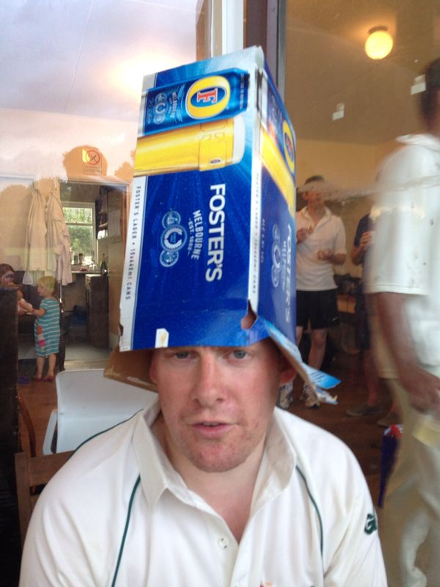
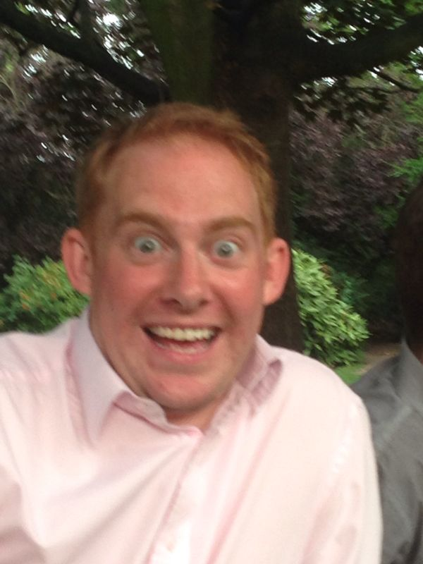
Captain’s Player of the Season
And the winner is…
Final count
11 votes - Thomo
10 votes - Ek
9 votes - Harty & JdM
7 votes - Pitcher, Boa & Louse
6 votes - Bilal
5 votes - TdM
4 votes - Cressey, Hampton,
Pontin & WLD
3 votes - KP, Becker & Naz
2 votes - Donald & Hillier
1 vote - Kaso & Chopra

Slide 26
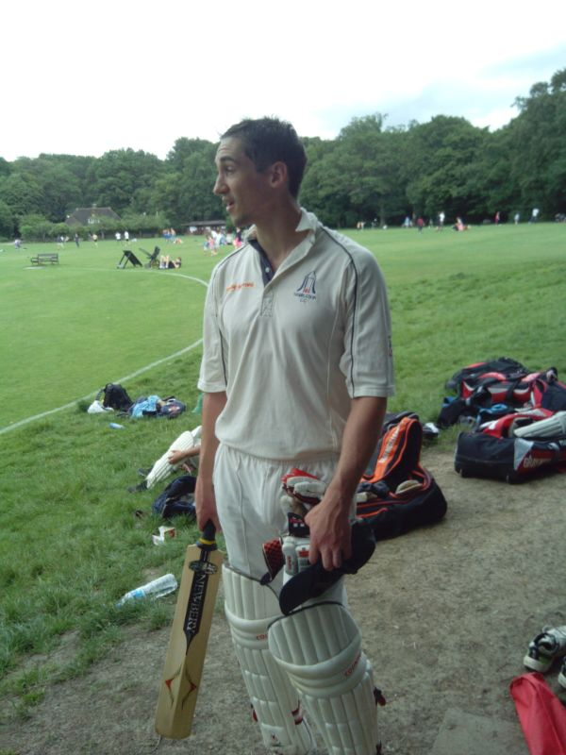
Most Improved – Saul Reid Award

Slide 27
Best newcomer

Slide 28
WAG of the year

Slide 29
WAG’s player of the year

Slide 30
Moment(s) of the season
Nominations included:
Louse’s back to back fivefers – nominated by Louse
Victory over Southwark and Lambeth at Parliament Hill
JdM’s slip catch at Old Whitgifts – nominated by a de Mellow
Bus ride back from Oxford – Crowded House karaoke
Ollie Ball’s post match dining habits
The team performance against HAC at HAC – best loss ever
Our loss to Hobgoblins, in particular the Sunday evening boozing which followed
Our 10 year anniversary celebrations
Thomo getting absolutely spanked by HAC’s Steve Parry to lose us the game
Thomo’s 3 wicket over against Agricola and the victory which followed
Troja’s innings against DemiJohns chasing 191 in 30 overs
EK’s six to win us the game against Beamers
But the winner is…

Slide 31
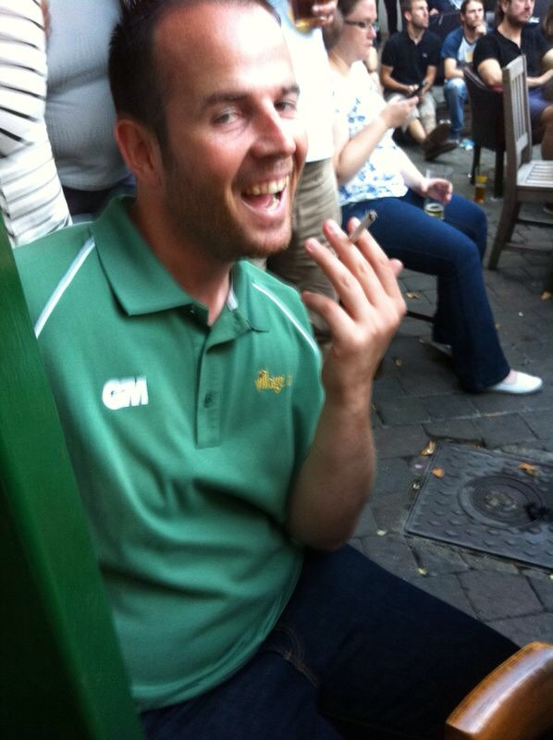
Best contribution on social media
Nominations included:
Chris Pitcher’s testing of the captain’s and group’s patience
SB Tang deactivating the Village Twitter
account
David Ireland red card
Parp’s arrival on the What’s App group and immediate captaincy bid
Bomb’s GIFs
Boa smoking & top XI of all time
Toby de Mellow - for no real reason
The creation of the What’s App group
JdM’s use (Santa, Whale, Shocked Face) suggestion that Whalers would have Ahab (c) on the team sheet

Slide 32
Players’ Player of the Year
“Ask not what your teammates can do for you. Ask what you can do for your teammates.” Magic Johnson
“The way a team plays as a whole determines its success. You may have the greatest bunch of individual stars in the word, but if they don't play together, the club wont be worth a dime.” Babe Ruth
“Player’s Player of the season: Selfish, but back-to-back fivefers was pretty awesome “ Craig Woodhouse

Slide 33
Corridor of Uncertainty
AA Page
Graham Pontin
WLD
KP
Bomb
John Lucarotti
Andy Richardson
Matt Boa

Slide 34
Finally a big thank you to this year’s Committee

Slide 35
2015 Committee Let the voting commence

